Slide 1
COFFEE SALES PERFORMANCE DASHBOARD PRESENTATION
PRESENTATION OF INSIGHTS, RECOMMENDATIONS AND STEPS TAKEN.

Slide 2
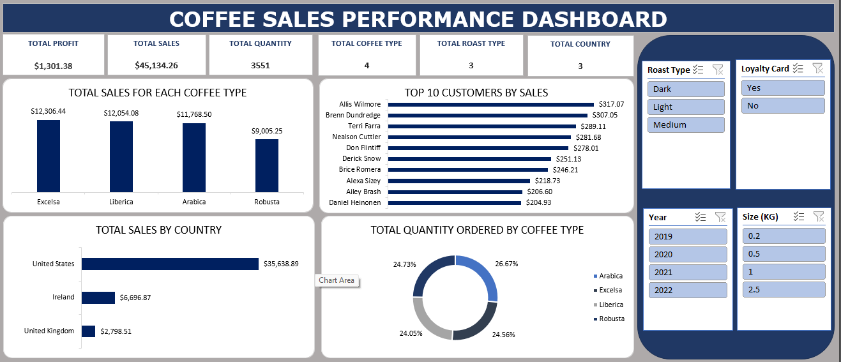
1.0 OVERVIEW OF THE DASHBOARD

Slide 3
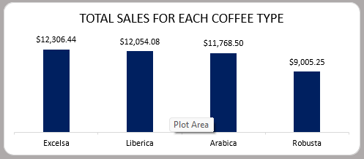
2.1 INSIGHTS DERIVED FROM THE DASHBOARD (CHART I)
From the chart, we can deduce that Excelsa was the most purchased coffee type, brought in approx. $12,306 sales.
The total sales made on the four (4) coffee types is approx. $45,134.
We could also deduce that each coffee type contributed significantly to the total sales.

Slide 4
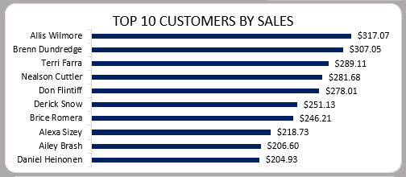
2.2 INSIGHTS DERIVED FROM THE DASHBOARD (CHART II)
Allis Wilmore leads the pack: With $317.07 in sales, Allis is the top customer, showing strong loyalty and high purchase value.
Close competition at the top Terri Farra ($307.05) and Don Flintiff ($289.11) are not far behind, suggesting a cluster of high-value customers that drive a big share of revenue.
Long-tail of steady contributors While customers like Brice Romera ($246.21) and Ailey Brash ($206.60) spend less, together they form a valuable mid-tier base that supports overall sales stability.

Slide 5
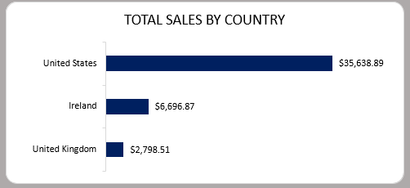
2.3 INSIGHTS DERIVED FROM THE DASHBOARD (CHART III)
The U.S. is the clear growth engine: With over $35,600 in sales, the United States is the coffee shop’s strongest market, accounting for the majority of total revenue. This shows that American customers are highly engaged and likely represent the business’s core audience.
Ireland is an emerging opportunity: At $6,696, Ireland generates much less than the U.S., but it still shows meaningful demand. This suggests there’s room for targeted marketing campaigns, partnerships with local cafés, or promotional offers to boost sales further.
United Kingdom needs more focus: With just $2,798, the U.K. lags other markets. This might reflect limited brand awareness or distribution issues. Strengthening presence through online sales, social media engagement, or collaborations could help capture more of this market.

Slide 6
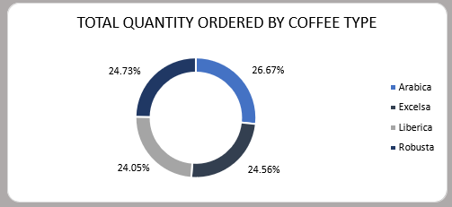
2.4 INSIGHTS DERIVED FROM THE DASHBOARD (CHART IV)
Customer demand is evenly spread across coffee types, showing no single one dominates preferences.
Arabica leads slightly at 26.67%, but Excelsa, Liberica, and Robusta closely follow—suggesting all types are equally valued by customers.
The near-balance in orders indicates strong opportunities to market variety packs or promote all coffee types equally, rather than focusing on just one.

Slide 7
3.0 RECOMMENDATIONs
Boost top markets: Strengthen U.S. presence while growing sales in Ireland and the UK.
2. Reward loyalty: Nurture top customers with perks, exclusives, and tailored offers.
3. Promote variety: Encourage mix-and-match packs to tap into balanced coffee demand.
4. Grow small spenders: Engage mid-tier customers with targeted promos and education.
5. Act on insights: Use the dashboard for quick, data-driven business decisions.

Slide 8
4.0 STEPS TAKEN
1. I merged the datasheet from orders, products, and customers using power query.
2. I cleaned and formatted the merged datasheet and created extra calculated column (Total Sales).
3. I built Pivot Tables and designed charts for each analysis.
4. I designed a dashboard and applied slicers.
5. I prepared a detailed presentation of the steps taken, insights and recommendations using Powerpoint tool.

